Slide 1
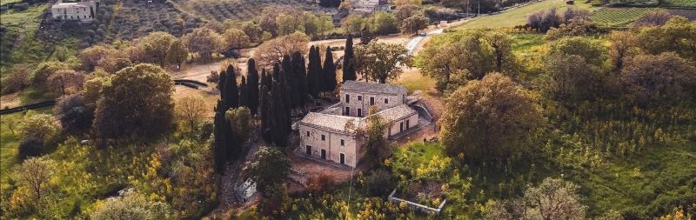
CIVIC MUSEUM CONTRADA MURATORE
Travel Guide:
Origins and new finds

Slide 2
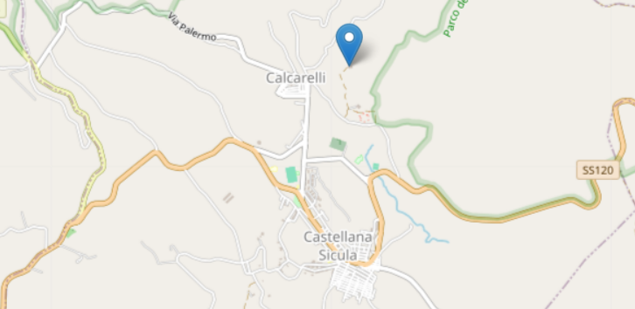
Where is he?
The Civic Museum is located in the Muratore district, outside the town of Castellana Sicula. The finds testify to the wealth of history of the territory of Castellana Sicula. The history of the building in which the museum is housed is decidedly interesting; a building that still incorporates hypogea from the late Roman age but which was perhaps born as a thermal structure, then became a farm, then transformed into an oil mill.

Slide 3
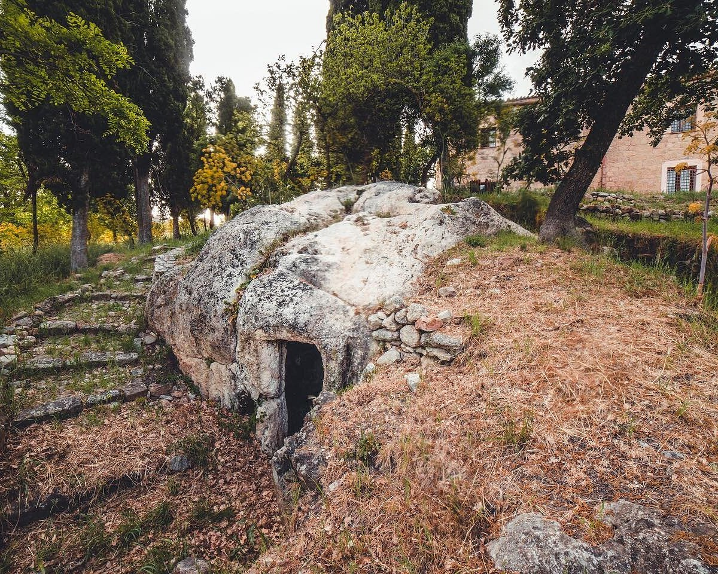
The origins
The Civic Museum is located within the archaeological area of the Muratore district, where a necropolis consisting of three hypogea entirely carved into the rock was found, one of which the largest is located inside the Museum. It consists of two sections: ethno-anthropological and archaeological.

Slide 4
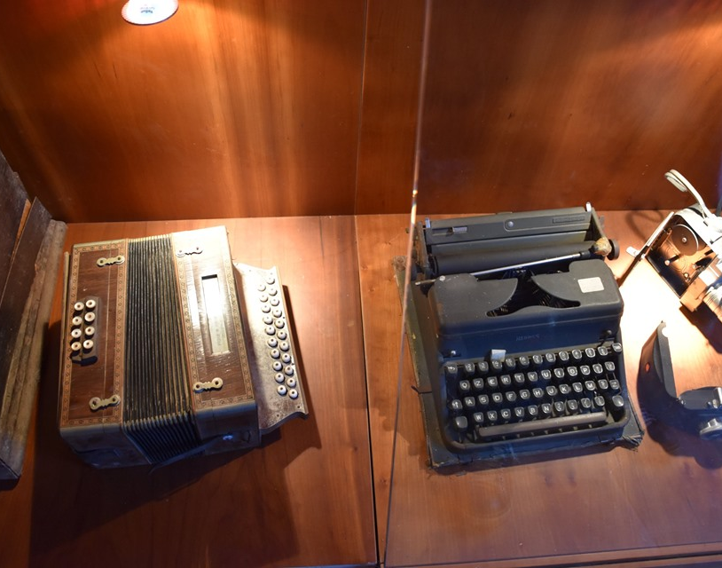
Ethno-anthropological section
The first, consisting of the collection of Father Abbot, donated to the Municipality, includes a small collection of archaeological finds of various origins, objects and work tools testifying to the local peasant culture and a singular collection of stuffed and formalin animals.

Slide 5
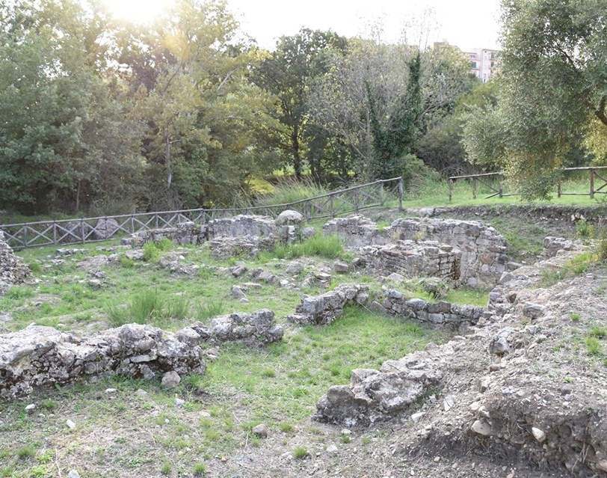
Archaeological section
The archaeological section exhibits finds found in the excavations conducted in c.da Muratore and some finds from surface archaeological reconnaissance carried out on Cozzo del Morto, Cozzo Zara, Monte Rotola Vecchia and Cozzo Re, attesting to the antiquity of the human settlement in these places, dating back to Prehistoric times.

Slide 6
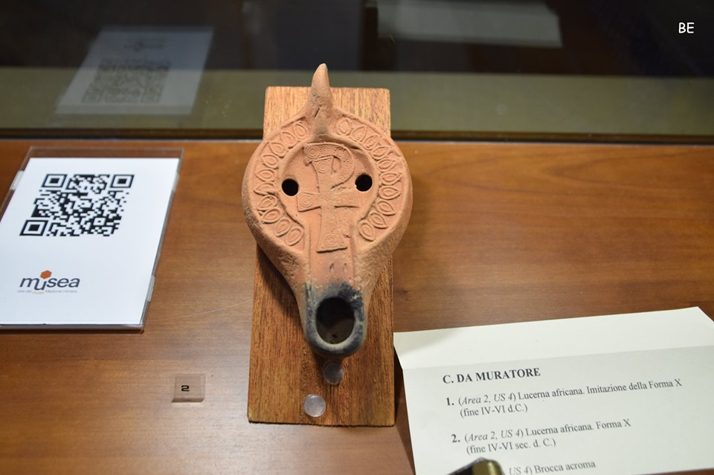
New finds
In 2001 the Archaeologist Valentino and in 2004 the Archaeologist Fontana, in collaboration with the Superintendence of Cultural Heritage of Palermo, started two excavation campaigns that brought to light the area of the town and the public area of a probable "pagus" of the Roman Imperial age. As far as the town is concerned, three main eras have been identified, a more recent medieval one, an older one from the late imperial age and one from the Hellenistic-Roman age.

Slide 7
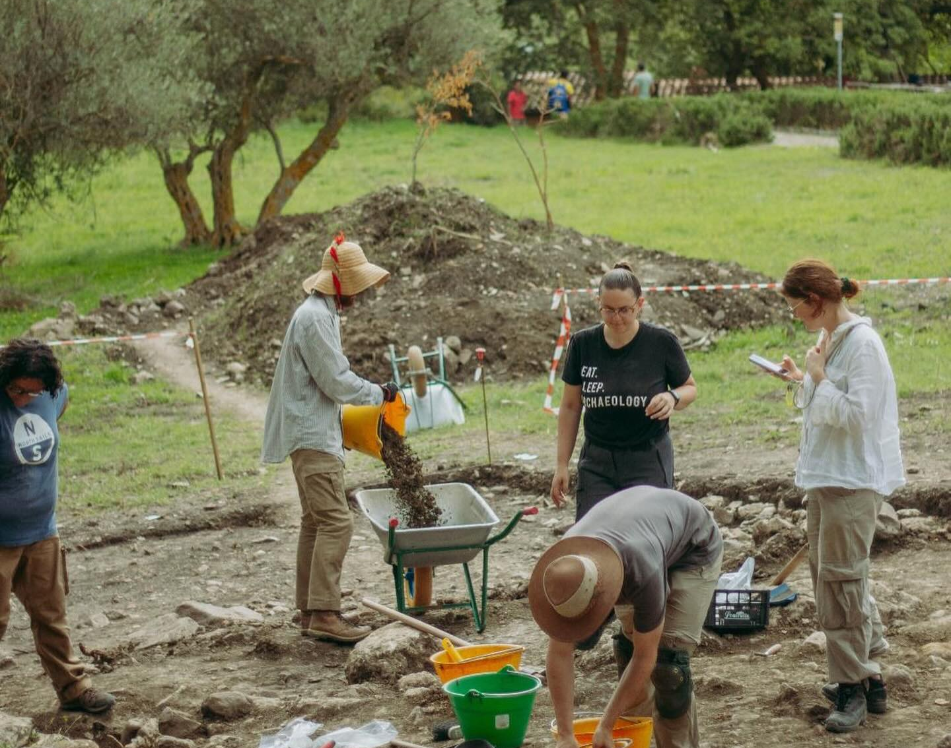
What did they find?
A considerable number of finds have been found: amphorae, jugs, early Christian oil lamps, bronze coins and black-painted ceramic fragments. A polylobed thermal system was also found, with a series of afferent rooms that revolve around a small internal courtyard, which have a paved floor of excellent workmanship and a sort of well-preserved ambulatory.

Slide 8
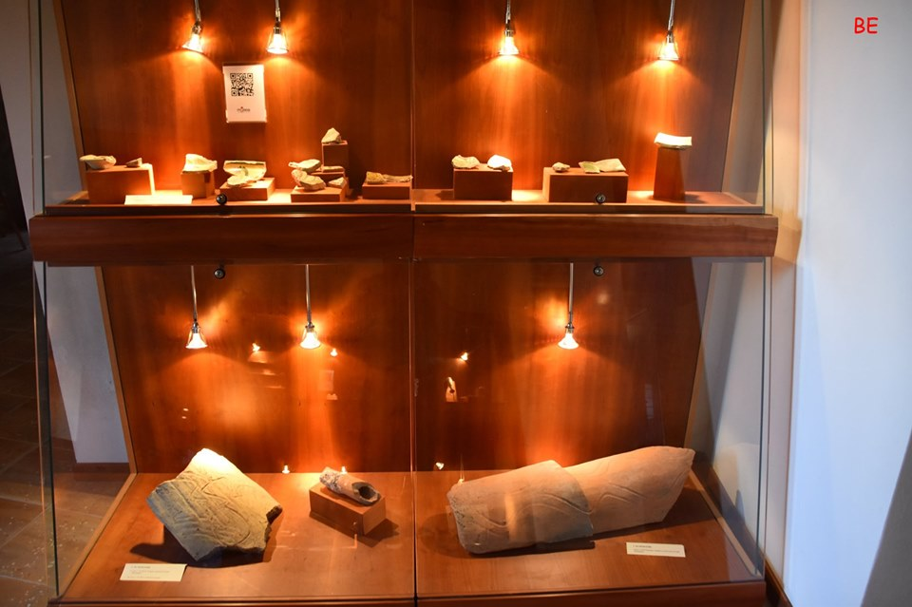
The rediscovered excellences
African amphora
Fuseruola
Digital Ring
Glazed basin
Wine filter
African Lucerne
Configured bronze lug

Slide 9
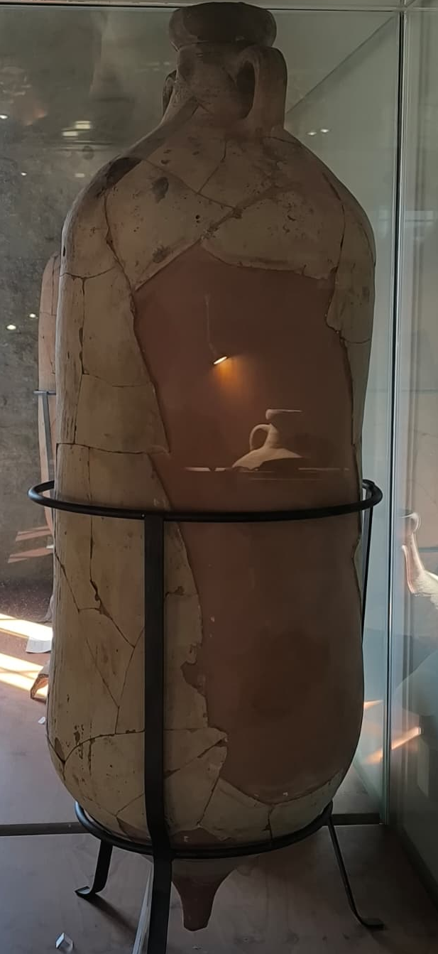
African amphora
African amphorae, in general, are ceramic containers designed for the transport and storage of liquids or flours. In north-western Africa (e.g. coastal regions near Carthage and other areas of the ancient Maghreb) amphorae were produced that were useful in the trade flow between Africa and the Mediterranean, especially from Punic times until the late Empire. The main purpose was to transport olive oil, wine, preserved fish, sometimes cereals or other commodities, along sea and river routes.

Slide 10
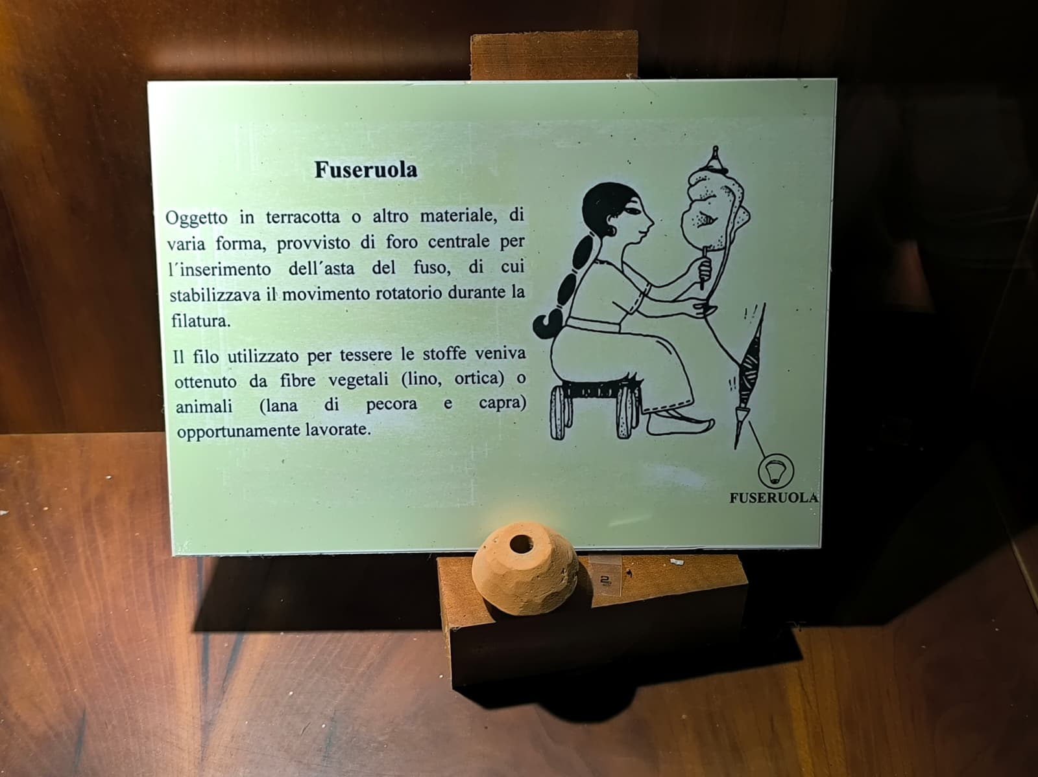
Fuseruola
A small disc or oval of terracotta (sometimes ceramic or stone) perforated in the centre, used as a counterweight on a spindle to transform fibres into thread.

Slide 11
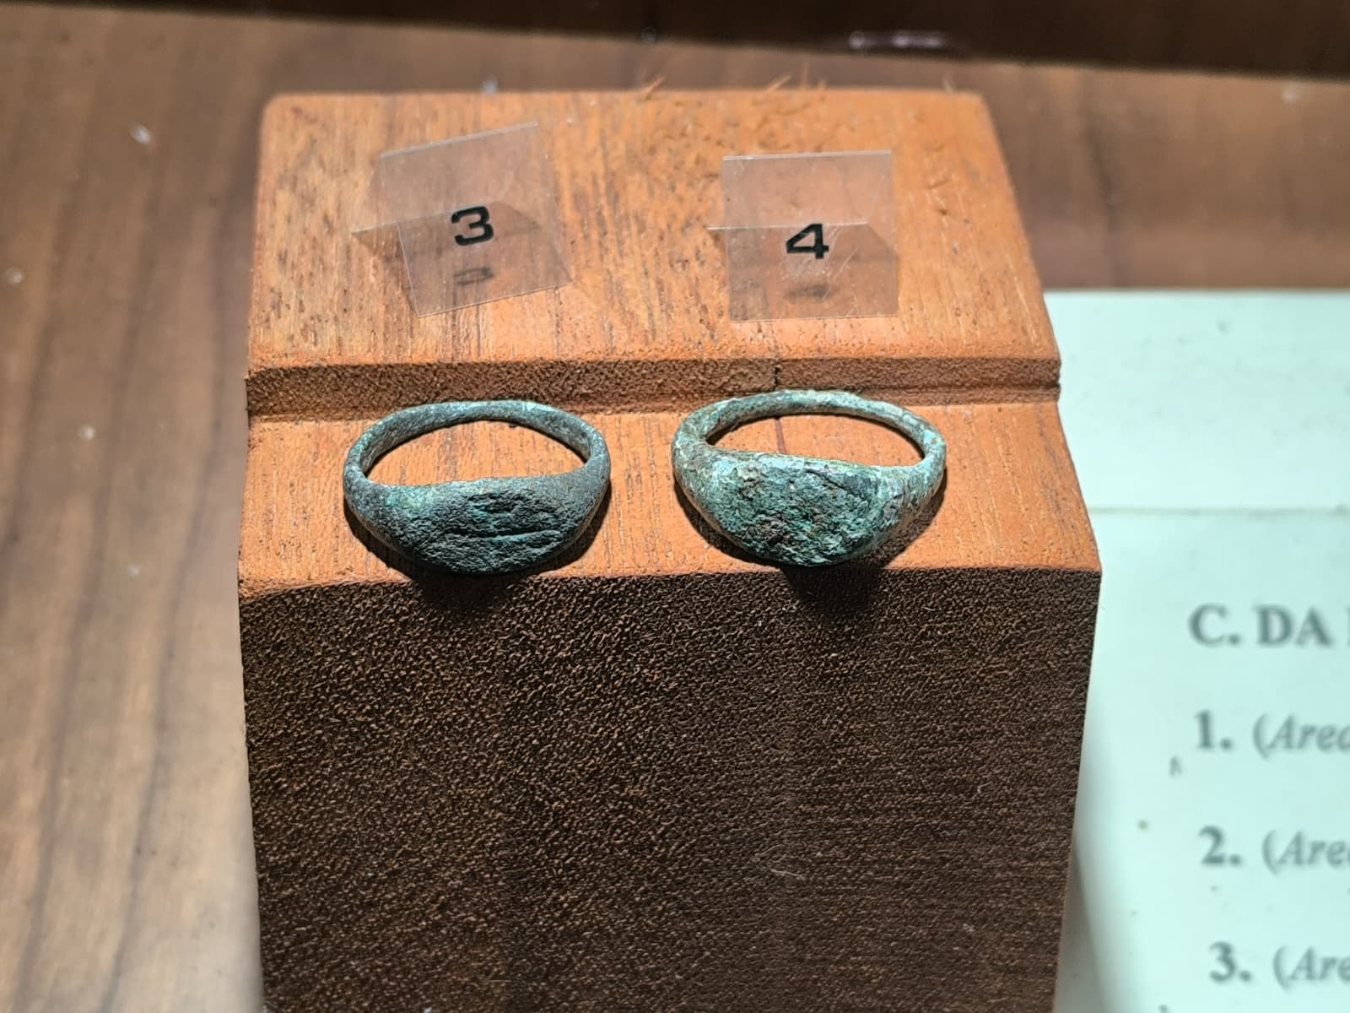
Digital Ring
A bronze ring (sigil or signet-engraved) used to protect documents or as a symbol of status, family or trade.

Slide 12
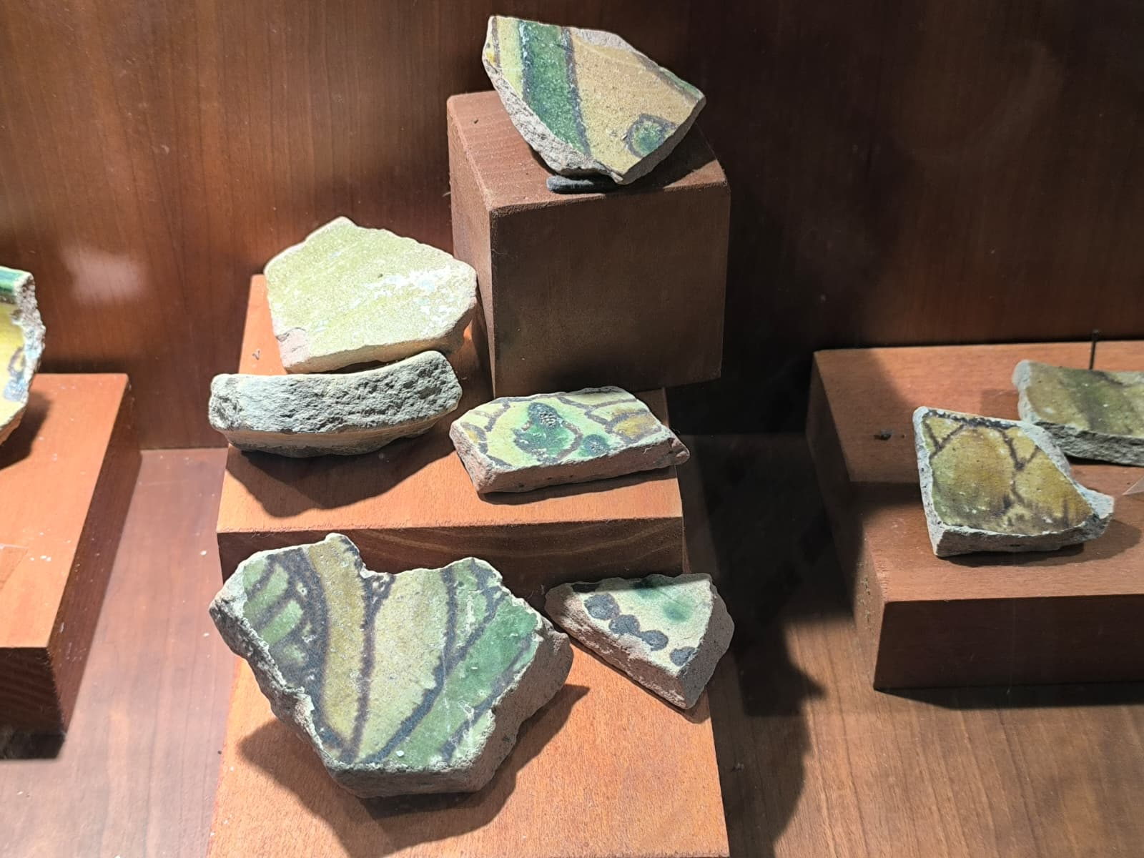
Glazed basin
It is a ceramic container/basin, of various shapes (round or flask), covered internally and externally with a vitreous layer (glaze) obtained by glazing and subsequent firing. The glazed coating makes the ceramic waterproof, shiny and often colored (transparent or with colors such as green, blue, yellow, brown).

Slide 13
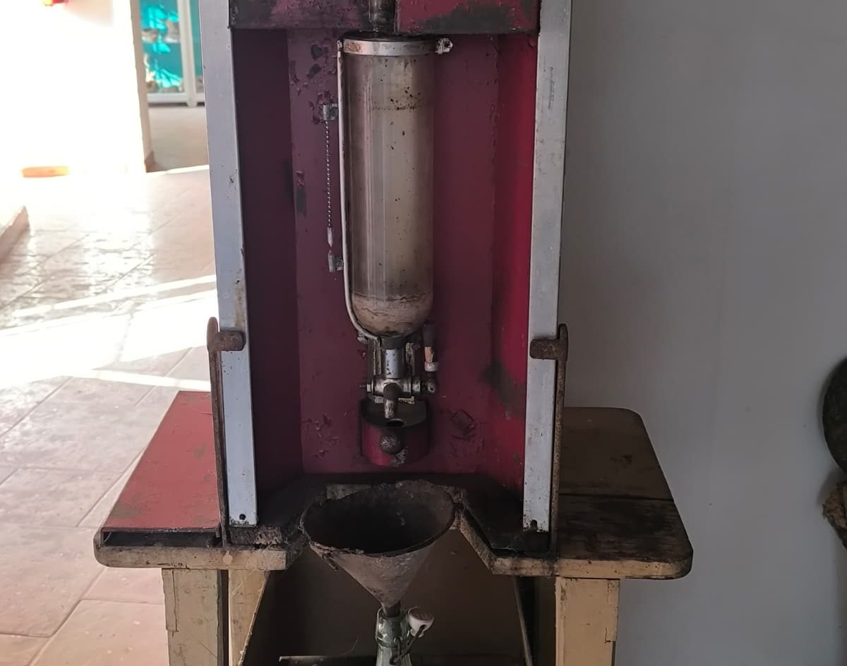
Wine filter
a ceramic or metal object (in the shape of a jug, cup, or small container) used to retain residues during decanting or to dose filtering liquids.

Slide 14
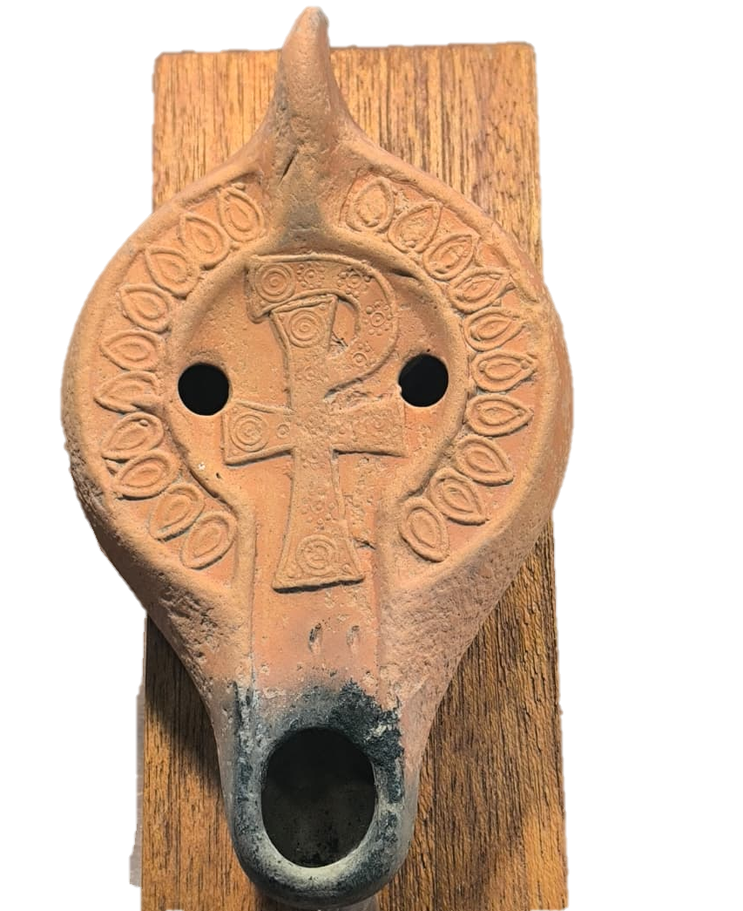
African Lucerne
container for oil and wick, which if lit was used to illuminate nocturnal environments, make rituals or travel.

Slide 15
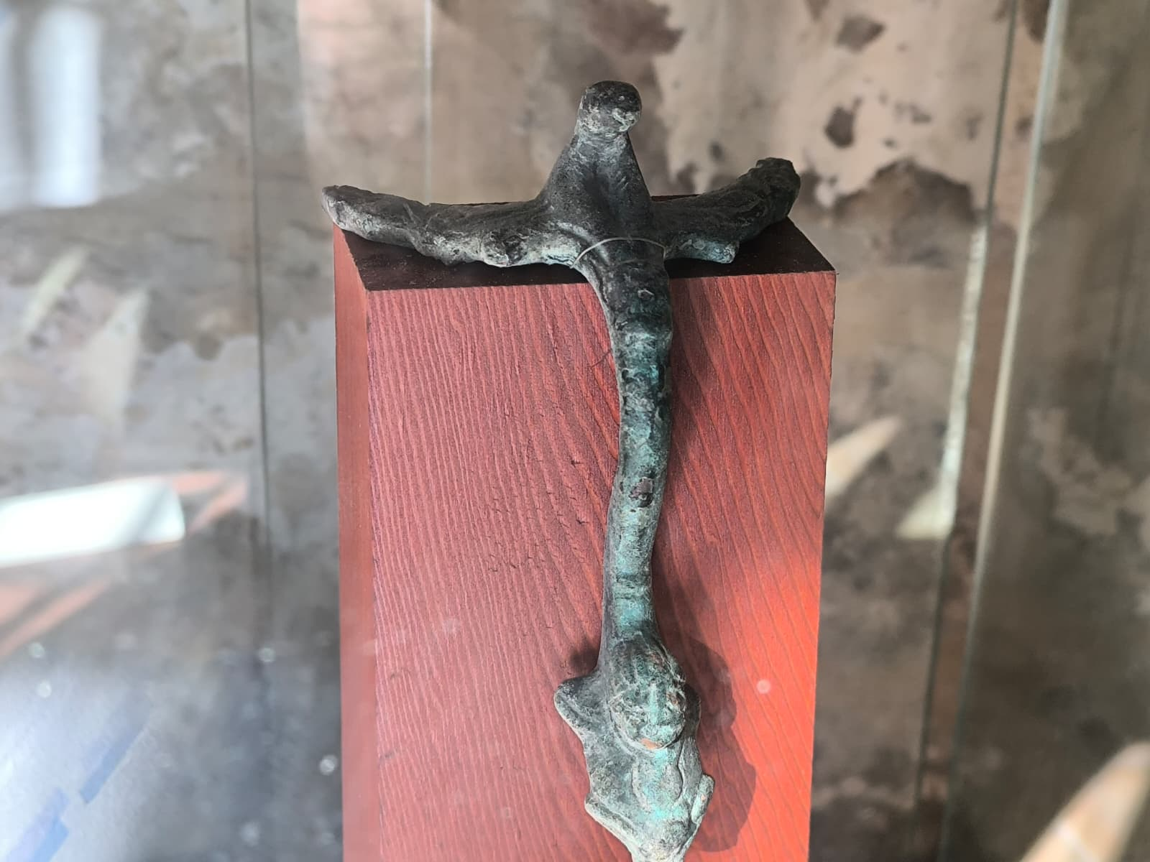
Configured bronze lug
allows the grip, hooking or suspending; It can be part of vessels, containers, fibulae kits, or tools.

Slide 16
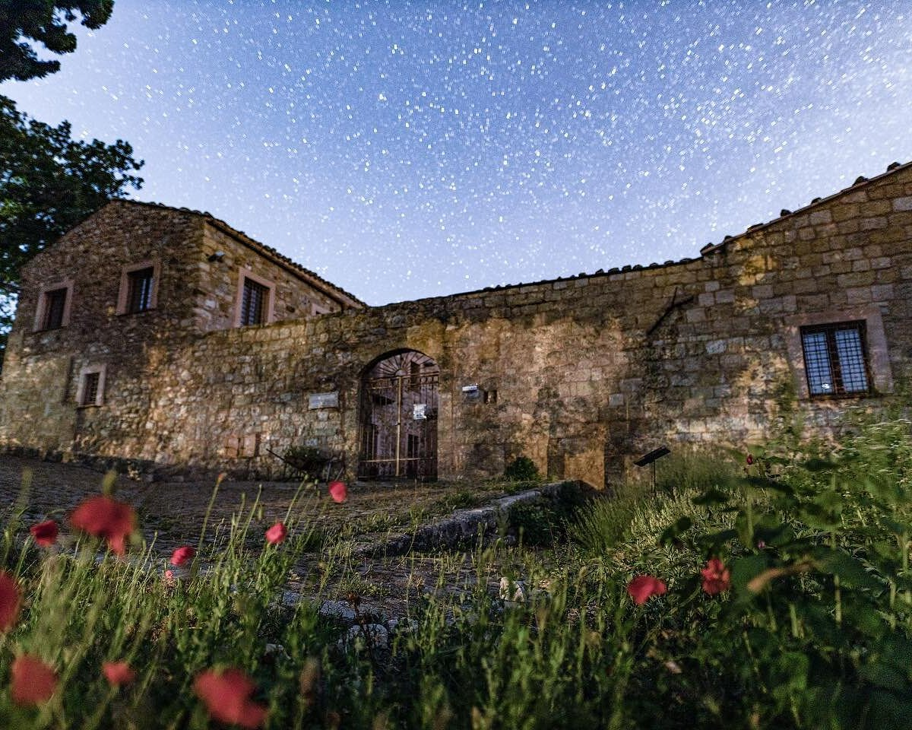
Some ethno-atroporological finds
stuffed tiger
soda machine

Slide 17
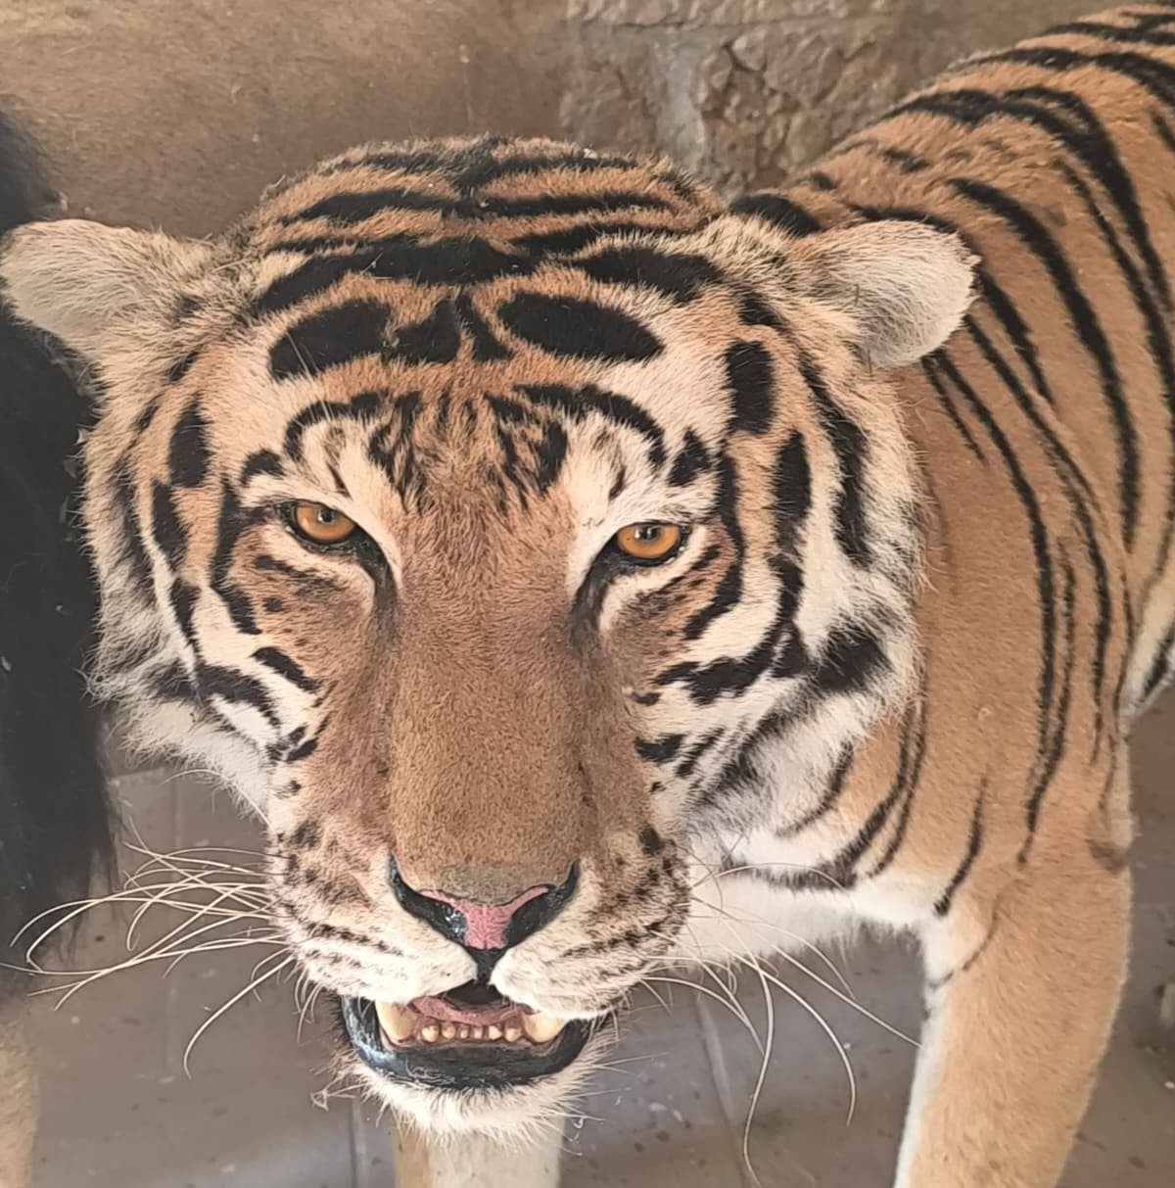
Stuffed tiger
This tiger is part of the vast ethno-anthropological collection, of the former. Parish priest of Castellana Sicula, Father Abbot, who collected several animals, including the prominent one, was the stuffed tiger.

Slide 18
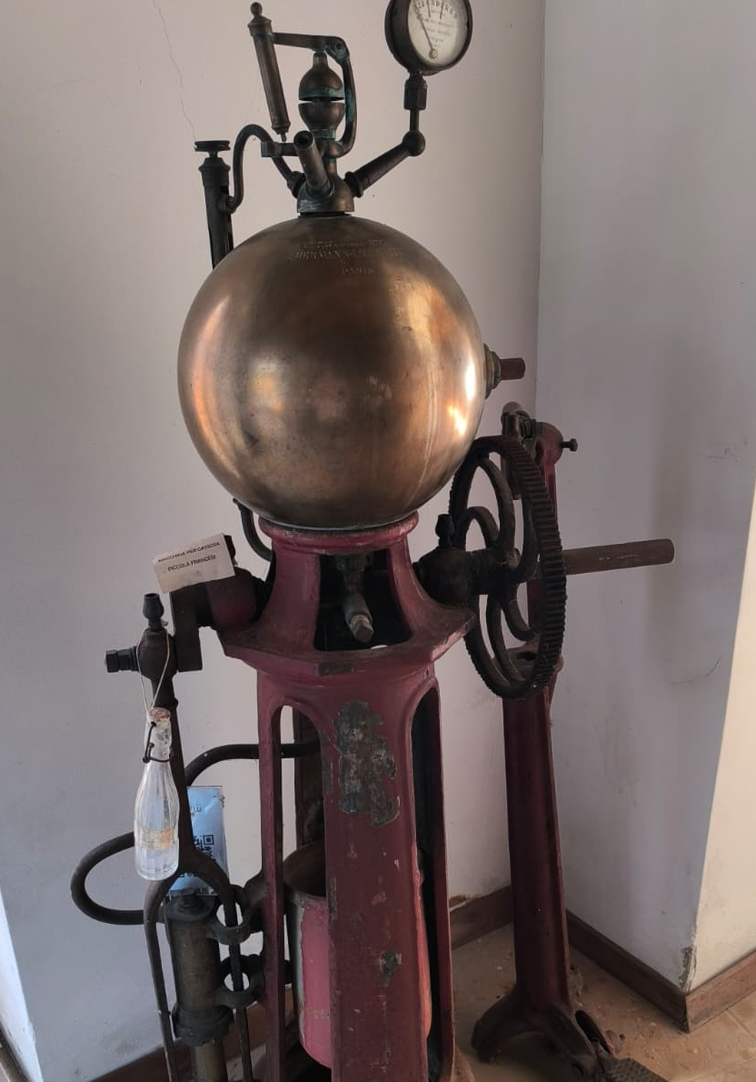
Soda machine
The French small soda machine was a machine used by local villagers to produce soda. Finally it was sold to the vast collection of Father Abate, which was then sold to the museum in the Muratore district

Slide 19
Thanks for watching
CONTACTS
EMAIL:
protocollo@pec.comune.castellana-sicula.pa.it
TELEPHONE: 3345420412

